Slide 1
Digital logic
In the field of computer science, binary logic is called digital logic. It is heart of the operation of all modern digital computers and an electronic devices. (Gurung, Baral &Baral, 2010)
Digital logic deals with variables that take two discrete(separate) values . The two values are called by different names such as true and false , yes and no etc. The binary bits are assigned by the values of 1 and 0
The binary logic introduced in this context is equivalent to an algebra known as “Boolean algebra”. The Boolean algebra is the algebra of logic. This algebra was developed by George Boole in 1854.

Slide 2
Definition of digital/binary logic
Binary logic consists of binary variables and logical operations. The variables are designated by letters of the alphabet such as A,B,C, X,Y,Z, etc. with each variable having two and only two distinct possible values: 1 and 0. There are three basic logical operations: AND, OR , NOT.
1. AND: This operation is represented by a dot or by the absence of an operator. For example, x. y = z or x y = z is read “X AND y is equal to z” the logical operation AND is interpreted to mean that z=1 if and only if x=1 and y=1; otherwise z=0;(remember that x, y, and z are binary variables and can be equal either to 1 or 0. and nothing else.)

Slide 3
Cont…
2. OR: This operation is represented by a plus sign. For example. X + y = z is read “x OR y is equal to z”, meaning that z= 1 if x=1 or if y=1 or if both x = 1 and y= 1. if both x =0 and y=o then z=0.
3.NOT: This operation is represented by a prim (sometimes by a bar). For example x’=z (or x =z) is read “x not is equal to z,” meaning that z is what x is not. In other words, if x=1, then z=0 but if x=0 then z=1.

Slide 4
Binary Logic and Gates
Binary variables take one of two values.
Logical operators operate on binary values and binary variables.
Basic logical operators are the logic functions AND, OR and NOT.
Logic gates implement logic functions.
Boolean Algebra: a useful mathematical system for specifying and transforming logic functions.
We study Boolean algebra as a foundation for designing and analyzing digital systems.

Slide 5
Logical Operations
The three basic logical operations are:
AND
OR
NOT
AND is denoted by a dot (·).
OR is denoted by a plus (+).
NOT is denoted by an over bar ( ¯ ), a single quote mark (') after, or (~) before the variable.
Boolean Algebra and Logic Gates 5

Slide 6
Binary Variables
Recall that the two binary values have different names:
True/False
On/Off
Yes/No
1/0
We use 1 and 0 to denote the two values.

Slide 7
All digital devices can be boiled down (reduced) to the three elementary Boolean functions commonly known as AND, OR and NOT.
These three elementary functions can be further combined to produce other functions: NAND (NOT of AND), NOR (NOT of OR) and the more complicated Ex-OR and Ex-NOR functions.

Slide 8
Truth Table
A truth table is a table representing the results of logical operations (on all possible combinations of logical values). The truth table for a logical circuit shows the outputs for all possible combinations of inputs.
1. AND Gate
AND gate is a logic circuit having two or more than two inputs and one output. The output of an AND gate is logic “1” only when all of its inputs are in logic “1” state. In all other cases, the output is logic “0”.

Slide 9
Diagram
Logic Diagram
Electrical Diagram
A
INPUT A
INPUT B
0
0
S1
S2
0
OUTPUT
CELL
BULB
B
A
INPUT A
INPUT B
0
0
S1
S2
1
OUTPUT
CELL
BULB
B
A
INPUT A
INPUT B
1
0
S1
S2
0
OUTPUT
CELL
BULB
B

Slide 10
Cont
A
INPUT A
INPUT B
1
1
S1
S2
1
OUTPUT
CELL
BULB
B
In above electrical analogue of an AND gate if one of the switches is ON or “1” the circuit remains open, hence the voltage in the output is “0” (i.e., bulb does not glow). Both the switches must be closed in order to give an output voltage (i.e., to glow the bulb).

Slide 11
Truth Table for AND Gate (with two inputs)
No. of inputs = 2, hence input combinations = 2² = 4
Input A | Input B | Output A AND B
0 | 0 | 0
0 | 1 | 0
1 | 0 | 0
1 | 1 | 1
Switch S1 | Switch S2 | Bulb
OFF | OFF | OFF
OFF | ON | OFF
ON | OFF | OFF
ON | ON | ON
Operation Symbol for AND gate is represented by a dot “.”, and Boolean Expression for AND function is f = A•B.

Slide 12
2. OR Gate
The OR gate is a logic circuit with two or more than two inputs and one output. The output of an OR gate is logic “1” when any one of its inputs are at logic “1” state. Only when both the inputs are at logic “0” the output of an OR gate is logic “0”.

Slide 13
Truth Table for OR Gate (with two inputs)
Input A | Input B | Output A OR B
0 | 0 | 0
0 | 1 | 1
1 | 0 | 1
1 | 1 | 1
Switch S1 | Switch S2 | Bulb
OFF | OFF | OFF
OFF | ON | ON
ON | OFF | ON
ON | ON | ON
Operation Symbol for OR gate is represented by a plus “+”, and Boolean Expression for OR function is f = A + B.

Slide 14
Logic Diagram Electrical Diagram
INPUT A
A
S1
0
0
S2
0
OUTPUT
CELL
INPUT B
BULB
B
INPUT A
A
S1
0
1
S2
1
OUTPUT
CELL
INPUT B
BULB
B
INPUT A
A
S1
1
1
S2
0
OUTPUT
CELL
INPUT B
BULB
B
INPUT A
A
S1
1
1
S2
1
OUTPUT
CELL
INPUT B
BULB
B

Slide 15
Cont…
In the above electrical analogue of an OR gate, if one of the switches or both the switches are closed or ON or “1”, the circuit remains closed . So, the voltage in the output is “1” (i.e., bulb glows). In the other case of the same gate, if both the switches are open(or off or 0), the output voltage is “0” (i.e., bulb does not glow).

Slide 16
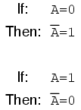
3. NOT Gate (or Inverter)
NOT gate is a logic circuit with one input one output logic gate whose output is always the complement of the input. E.g., logic “0” at the input produces logic “1” at the output and vice versa. It is also known as a Complementing Circuit or an Inverting Circuit

Slide 17
Logic Diagram Electrical Diagram
A
Ā
1
CELL
S1
BULB
0
OUTPUT
INPUT A
A
Ā
1
0
S1
OUTPUT
CELL
BULB
INPUT A

Slide 18
Truth Table for NOT Gate (with two inputs)
No. of inputs = 1, hence input combinations = 2¹ = 2
Input A | Output NOT A
0 | 1
1 | 0
Switch S1 | Bulb
OFF | ON
ON | OFF
Operation Symbol for NOT gate is represented by a bar “ ¯ “ , and Boolean Expression for NOT function is f = Ā.

Slide 19
4. NAND Gate
NAND gate is obtained by complementing the output of an AND gate. It stands for NOT – AND. The truth table of NAND gate is obtained from the truth table of an AND gate by complementing the output entries. The output of a NAND gate is logic “0” when all its inputs are logic “1”. For all other cases the output is logic “1”.

Slide 20
Truth Table for NAND Gate (with two inputs)
No. of inputs = 2, hence input combinations = 2² = 4
Input A | Input B | Output A NAND B
0 | 0 | 1
0 | 1 | 1
1 | 0 | 1
1 | 1 | 0
Switch S1 | Switch S2 | Bulb
OFF | OFF | ON
OFF | ON | ON
ON | OFF | ON
ON | ON | OFF
Boolean Expression for NAND function is f =

Slide 21
Logic Diagram Electrical Diagram
0
CELL
S1
INPUT A
BULB
1
0
OUTPUT
S2
INPUT B
0
CELL
S1
INPUT A
1
BULB
OUTPUT
S2
1
INPUT B
1
CELL
S1
INPUT A
1
BULB
0
OUTPUT
S2
INPUT B

Slide 22
1
CELL
S1
INPUT A
0
BULB
1
OUTPUT
S2
INPUT B

Slide 23
5. NOR Gate
NOR gate is obtained by complementing the output of an OR gate. It stands for NOT – OR. The truth table of NOR gate is obtained from the truth table of an OR gate by complementing the output entries. The output of a NOR gate is logic “1” when all its inputs are logic “0”. For all other cases the output is logic “0”.

Slide 24
Truth Table for NOR Gate (with two inputs)`
No. of inputs = 2, hence input combinations = 2² = 4
Input A | Input B | Output A NOR B
0 | 0 | 1
0 | 1 | 0
1 | 0 | 0
1 | 1 | 0
Switch S1 | Switch S2 | Bulb
OFF | OFF | ON
OFF | ON | OFF
ON | OFF | OFF
ON | ON | OFF
Boolean Expression for NOR function is f =

Slide 25
Logic Diagram Electrical Diagram
A
0
CELL
INPUT B
1
S1
S2
BULB
0
OUTPUT
INPUT A
B
A
0
CELL
INPUT B
0
S1
S2
BULB
1
OUTPUT
INPUT A
B
A
1
CELL
INPUT B
0
S1
S2
BULB
0
OUTPUT
INPUT A
B
A
1
CELL
INPUT B
0
S1
S2
BULB
1
OUTPUT
INPUT A
B

Slide 26
6. Exclusive OR Gate (XOR)
Exclusive OR gate is configured (arranged) with two or more inputs. If we compare the truth table for a 2 input OR and a 2 input Exclusive OR there is only one difference. The output of an Exclusive OR gate is logic “0” when both its inputs are logic “1” or logic “o”. (The output is “0” when only both inputs are “0” in the case of OR gate)

Slide 27
Truth Table for XOR Gate (with two inputs) No. of inputs = 2, hence input combinations = 2² = 4
Input A | Input B | Output A XOR B
0 | 0 | 0
0 | 1 | 1
1 | 0 | 1
1 | 1 | 0
Switch S1 | Switch S2 | Bulb
OFF | OFF | OFF
OFF | ON | ON
ON | OFF | ON
ON | ON | OFF

Slide 28
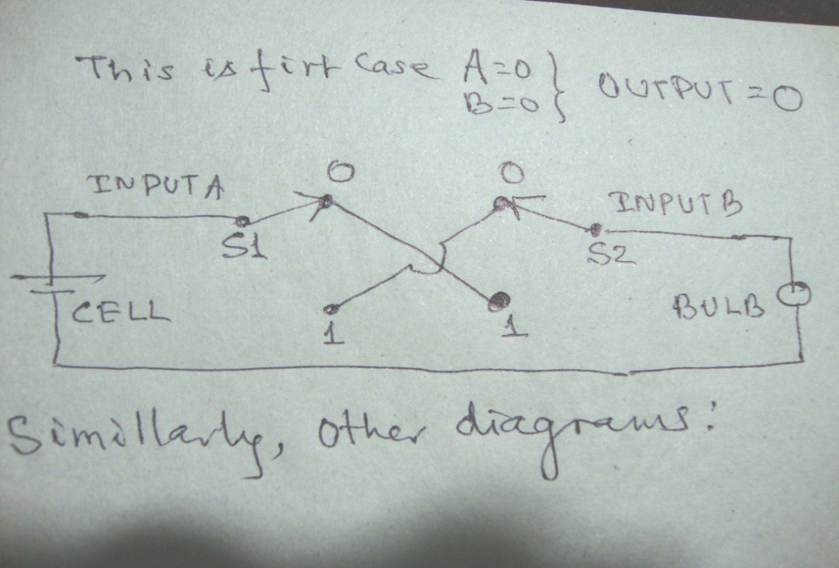

Operation Symbol for XOR gate is represented by an encircled plus , and Boolean Expression for XOR function is f = A +B.
Logic Diagram Electrical Diagram
A
0
0
0
INPUT A
INPUT B
0
S1
1
1
S2
0
OUTPUT
CELL
BULB
B
A
0
0
0
INPUT A
INPUT B
1
S1
1
1
S2
1
OUTPUT
CELL
BULB
B

Slide 29
Cont… Logic gate
A
0
0
1
INPUT A
INPUT B
1
S1
1
1
S2
0
OUTPUT
CELL
BULB
B
A
0
0
1
INPUT A
INPUT B
0
S1
1
1
S2
1
OUTPUT
CELL
BULB
B

Slide 30
In the Electric diagrams , the X type is not connected at the crossings. So if the switches touch its both ends then only the circuit will be completed.
So it is clearly seen that, in the first diagram, when Input A = 0 and Input B = 0 the circuit is not completed, as the switch S1 and S2 do not connect each other, hence the output is 0.
In the second diagram, when input A = 0 and Input B = 1 the circuit is completed, as the switch S1 and S2 connect each other, hence the output is 1.
In the third diagram, when input A = 1 and Input B = 0 the circuit is completed, as the switch S1 and S2 connect each other, hence the output is 1.
In the fourth diagram, when input A = 1 and input B = 1, the circuit is not completed, as the switch S1 and S2 do not connect each other, hence the output is 0.

Slide 31
7. XNOR Gate
XNOR is the output complement of XOR gate. It stands for NOT – XOR. The truth table of XNOR gate is obtained from the truth table of an XOR gate by complementing the output entries. The output of a XNOR gate is logic “1” when all its inputs are equal to logic “1”. when all the inputs are unequal, the output is logic “0”.

Slide 32
Truth Table for XNOR Gate (with two inputs)` No. of inputs = 2, hence input combinations = 2² = 4
Input A | Input B | Output A XNOR B
0 | 0 | 1
0 | 1 | 0
1 | 0 | 0
1 | 1 | 1
Switch S1 | Switch S2 | Bulb
OFF | OFF | ON
OFF | ON | OFF
ON | OFF | OFF
ON | ON | ON
Boolean Expression for XNOR function is f =

Slide 33
A
0
f
OUTPUT
0
B

Slide 34
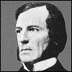
BOOLEAN ALGEBRA
Boolean algebra is the algebra of logic. It is a two valued system of algebra that is used to represent logical relation ships and operations. It is widely used to analyze design logic circuits which are the basis for digital electronics and digital computers.
Boolean algebra concerns an arithmetic with just two values. These values are often denote by T and F, where T stands for “true” and F stands for “false”. Usually we will use 1 in place of T and 0 in place of F. However it is very useful to remember the logical association of true and false.
British mathematician and logician George Boole developed Boolean algebra in 1854
This algebra was introduced in his book “ An Investigation of the Laws of Thought”. ( the term "Boolean algebra" was first suggested by Sheffer in 1913) It is a two valued system of algebra used to represent logical relationships and operations. It means, it deals with binary number system.
http://www.allaboutcircuits.com/vol_4/chpt_7/3.html

Slide 35
BOOLEAN ALGEBRA
It is now widely used to analyze and design logic circuits. The logic circuits are the basis for digital electronic and digital computers. The circuits in computer as well as other digital electronic devices have inputs, each of which is either a 0 or a 1, and produce outputs that are also either, 0 or 1. The digital electronic circuits can be constructed using any basic elements that have distinct two states. The two distinct states can be ON or OFF in switches; reflective or non reflective optical medium.

Slide 36
A form of symbolic logic, in which variables, which stand for proposition, have only the values "true" (or "1") and "false" (or "0"). Relationships between these values are expressed by the Boolean operators AND, OR, and NOT. For example, "a + b" means "a OR b", and its value is true as long as either a is true or b is true (or both). Boolean logic can be used to solve logical problems, and provides the mathematical tools fundamental to the design of digital computers. It is named after the mathematician George Boole. Also called Boolean logic. See also logic gate

Slide 37
Tips Boolean algebra
Boolean algebra is the sub-area of algebra in which the values of the variables are the truth values true and false, usually denoted 1 and 0 respectively .
It is a two valued system of algebra used to represent logical relationships and operations. It means, it deals with binary number system. In Boolean algebra, logical proposition are represented by symbols and abstract mathematical operators.

Slide 38
In simple terms, Boolean algebra is a system of mathematical logic which differs from both the conventional algebra and the binary arithmetic. For example, in Boolean algebra,
1 + 1 = 1
Where + is the logical operation OR and not the simple addition.
In Boolean algebra, the variables permitted have two values “true” or “false” usually written as 1 and 0 respectively. The Boolean operations on the variables are limited to three basic logic operations AND, OR and NOT. Two states of Boolean variables i.e., true and false may be represented by ON and OFF states of electronic switching circuits respectively.

Slide 39
In the world of Boolean algebra, there are only two possible values for any quantity and for any arithmetic operation: 1 or 0. There is no such thing as “2” within the scope of Boolean values.

Slide 40
9. Boolean algebraic identities
Basically, there are two categories of Boolean algebric identity. They are:
Additive
Multiplicative
Additive: It is related to addition. It has following categorization
a. A + 0 = A
The first Boolean identity is that the sum of anything and zero is the same as the original "anything." This identity is no different from its real-number algebraic equivalent. This identity is similar to the normal algebra. For example:
A + 0 = A
No matter what the value of A, the output will always be the same: when A= 1, the output will also be 1; when A=0, the output will also be 0.
b. A + 1 = 1
The next identity is most definitely different from a normal algebra. Here we discover that the sum of anything and one is one:
A + 1 = 1

Slide 41
Cont.
No matter what the value of A, the sum of A and 1 will always be 1. In a sense, the "1" signal overrides (dominates) the effect of A on the logic circuit.
c. A + A = A
In real-number algebra, the sum of two identical variables is twice the original variable's value (x + x = 2x), but remember that there is no concept of "2" in the world of Boolean math, only 1 and 0. So, we cannot say that A + A = 2A. Thus, when we add a Boolean quantity to itself, the sum is equal to the original quantity: 0 + 0 = 0, and 1 + 1 = 1.
A + A = A

Slide 42
Cont
d. A + Ā = 1
This is an unique Boolean concept of complementation into an additive identity. We find an interesting effect. According to this identity, there must be one "1" value between any variable and its complement, and since the sum of any Boolean quantity and 1 is 1, the sum of a
A + Ā = 1
2. Multiplicative identity
It is related to multiplication. There are also four multiplicative identities: Ax0, Ax1, AxA, and AxA'. Of these, the first two are no different from their equivalent expressions in regular algebra:
0 A = 0
1 A = A

Slide 43
Cont…
The third multiplicative identity expresses the result of a Boolean quantity multiplied by itself. In normal algebra, the product of a variable and itself is the square of that variable (3 x 3 = 3² = 9). However, the concept of "square" implies a quantity of 2, which has no meaning in Boolean algebra, so we cannot say that A x A = A². Instead, we find that the product of a Boolean quantity and itself is the original quantity, since 0 x 0 = 0 and 1 x 1 = 1:
A A = A

Slide 44
Cont…
The fourth multiplicative identity has no equivalent in regular algebra because it uses the complement of a variable, a concept unique to Boolean mathematics. Since there must be one "0" value between any variable and its complement, and since the product of any Boolean quantity and 0 is 0, the product of a variable and its complement must be 0:
A Ā = 0
To summarize, then, we have four basic Boolean identities for addition and four for multiplication:

Slide 45
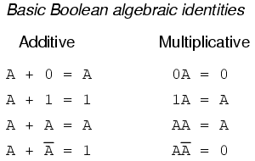
Basically, there are two categories of Boolean algebric identity. They are:
Additive
Multiplicative

Slide 46
10. Boolean Laws
10.1 AND Laws
The Boolean expression with two inputs for AND function is: f = A AND B = A•B which implies that f is True only if A and B both are true.
10.2 OR Laws
The Boolean expression with two inputs for OR function is: f = A OR B = A + B which implies that f is True if any one of A or B or both are true.
10.3 NOT Laws
The Boolean expression with one input for NOT function is: f = NOT A = Ā which implies that f is True only if A is false.

Slide 47
10.4 Commutative Laws
The commutative laws tell us we can reverse the order of variables that are either added together or multiplied together without changing the truth of the expression. It is expressed as:
A + B = B + A(Commutative property of addition)
A•B = B•A (Commutative property of multiplication)

Slide 48
10.5 Associative Laws
The associative laws tell us we can associate groups of added or multiplied variables together with parenthesis without altering the truth of the equations. It is expressed as:
A + (B + C) = (A + B) + C (Associative property of addition)
A (BC) = (AB) C (Associative property of multiplication)

Slide 49
10.6 Distributive Laws
The distributive property illustrates how to expand a Boolean expression formed by the product of a sum, and in reverse shows us how terms may be factored out of Boolean sums-of-products. It is expressed as:
A (B + C) = AB + AC

Slide 50
10.7 Idempotent Laws
The effect of adding A and A together, which is the same as connecting both inputs of an OR gate to each other and activating them with the same signal:
A + A = A
we cannot say that A + A = 2A. Thus, when we add a Boolean quantity to it, the sum is equal to the original quantity: 0 + 0 = 0, and 1 + 1 = 1. It can be extended to any number of input i.e.,
A + A + A + A … … … … … … + A = A

Slide 51
we find that the product of a Boolean quantity and itself is the original quantity, since 0 x 0 = 0 and 1 x 1 = 1:
AA = A It can be extended to any number of input i.e,
A . A . A . A … … … … … … … … A = A

Slide 52
10.8 Absorption Laws
The effect of Boolean quantity A multiplied with the addition of the same Boolean quantity A and another quantity B together, is the Boolean quantity A itself.
A . (A + B) = A

Slide 53
A . (A + B) = A
We can prove it as follows:
L.H.S. = A . (A + B)
= A . A + A . B (Distributive Law)
= A + A . B (Idempotent Law)
= A (1 + B) (Distributive Law)
= A. 1 (A + 1 = 1 then, 1 + B = 1)
= A
= R.H.S.

Slide 54
DeMorgan’s theorems
Statement 1: The complements of the sum of the Boolean variables are equal to the product of their individual complements i.e (A+B)’=A’.B’. the theorem can e proved two methods Truth table method and by using laws of Boolean algebra We can –proved that : (A+B)’=A’.B’

Slide 55
Cont..
(A+B)’=(A’.B’) given statement
Or (A+B).(A+B)’= (A+B).(A’.B’) Multiplying both sides by (A+B)
Or 0 = (A+B).(A’.B’) we are already know that A.A’= 0
i.e. (A+B).(A’.B’) =0
Now take LHS and follow same as above:
= (A+B).(A’.B’)
=(A’.B’).(A+B) commutative laws =A.B=B.A
=(A’.B’.A) + (A’.B’.B) Distribute laws
=(.B’.A. A’) + (A’. B’.B) commutative laws
=(B’.0)+(A’.0) multiplicative inverse A.A’=0
=0+0 multiplicative identity A.0=0
=0

Slide 56
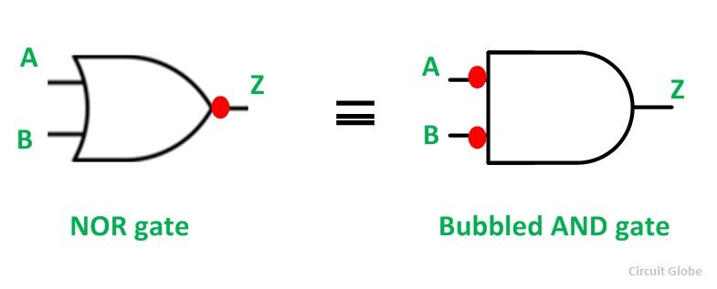
The symbolic representation of the theorem is shown in the figure below.
(A+B)’=A’.B’

Slide 57
Statement 2: The complements of the product of the Boolean variables are equal to sum of their individual complements i.e (A.B)’=A’+B’
(A.B)’=A’+B’ given statement
or (A.B) .(A.B)’=(A’+B’). (A.B) Multiplying both sides by (A.B)
or 0=(A’+B’). (A.B) we are already know that A.A’= 0
i.e. (A’+B’). (A.B) = 0
Now again take LHS,
(A’+B’). (A.B)
= (A.B.A’)+(A.B.B’) Distribute laws A.(B+C)=A.B+A.C
=(B.A.A’)+( A.B.B’) Commutative laws A.B=B.A
=(B.0)+ (A.0) multiplicative inverse A.A’=0
=0+0 multiplicative identity A.0=0
=0

Slide 58
